Slide 1
Different Healthcare Systems
Michael Teasdale
OLLI
February-March, 2016

Slide 2
Course Agenda
Date | Topic
Feb 15 | Comparing performance of healthcare systems
Feb 22 | Why does the US system cost so much?
Feb 29 | Why does the US Systems cost so much ? An overview of other healthcare systems
March 7 | Other Healthcare systems; policy alternatives and a framework
An overview of 3 healthcare systems
A simple framework to evaluate healthcare systems

Slide 3
Agenda
Understand other healthcare systems
France
Canada
UK
Sweden (short)
Identify some takeaways
Build a framework to use to compare proposals to change the US Healthcare system

Slide 4
Some Catch up definitions
Reimbursement: money from a payor (like an insurance company, Minister of Health or Statutory Health Insurance Fund (SHI)) to pay for a service, a procedure, or product ( drug or device). Reimbursement is revenue to the provider of the service or device or to the end customer.
Provider: a person or organization that provides services or product. This can be a doctor, hospital, clinic or social worker
Payor: the organization responsible to pay for the service or device: Insurance companies, HMOs, SHIs

Slide 5
Single Payer definition
Single-payer healthcare is a universal health care system where a “single payer” fund, rather than multiple private insurers, pays for health care costs. The “single payer” part refers to funding, not delivery. A single payer fund can have a private healthcare delivery system, a public delivery system, or a mix of the two. A fund can be controlled by any agency, but is typically organized and overseen by the government.
The term "single-payer" thus only describes the funding mechanism. The gov’t can oversee several payers but due to regulations, nevertheless the system is called “single payer.” In this sense, the UK Health Care system is technically not "single payer", as in reality it consists of a number of financially and legally autonomous Trusts but all overseen by NHS
The actual funding of a "single payer" system comes from all or a portion of the covered population. Although the fund holder is usually the state, some forms of single-payer use a mixed public-private system
When Americans talk national health care or socialist healthcare they usually mean single payer systems

Slide 6
French Over view
Healthcare triage
https://www.youtube.com/watch?v=_yF69KVbUaQ&index=4&list=PL7TpDQnTTUjPThx2t0L4PfIEbv2Em7bXg
CBS report
https://www.youtube.com/watch?v=uNR_6UuVl4s&index=6&list=PLAOMWcKiClHR9XX3r-uYwjEvTdviaknHf

Slide 7
French HC Summary
Universal care; mandatory participation
Single payer: 5 Statutory Health Insurance organizations (non profit) regulated by central gov’t
Gov’t sets healthcare strategy and policy:
Manages negotiations for fees for doctors, drugs, and procedures
Allocates and approves budget for investments
Doctors largely self employed, but have lower incomes; hospitals are public, private and not profit – all regulated by gov’t
Total choice of provider, some voluntary gatekeeping through GPs
Complementary healthcare insurance for 92% of population to cover co-pays
Low out of pocket spending – 50 euro cap; co-pays regulated by sickness
Gov’t payer with a mix of private and public delivery of care

Slide 8
French Pros and Cons
Pros
Universal care
World leading outcomes
Low co-pays
High service levels
Free choice of providers
Innovative (telemedicine, infectious diseases, IT, )
Cons
Expensive?
Is French Healthcare the model for developed countries?

Slide 9
Canadian HC triage video
https://www.youtube.com/watch?v=1TPr3h-UDA0

Slide 10
Canadian Summary
Universal coverage, little out of pocket cost
Gov’t administered single payer system, Federal gov’t negotiates for doctor fees, drugs and major healthcare investments
No co-pays for public services, hospitals function under gov’t budgets
Physicians, self employed, work on a fee for service basis; well payed
Financed primarily by taxes (provincial gov’ts run the system with subsidies from Federal gov’t) and private premiums (through employers)
Complementary, private insurance covers services not covered by public reimbursement (vision, dental, home care, private rooms in hospitals, etc)
Public spending, but private delivery system

Slide 11
Canada Pros and Cons
Pros
Universal care
Low co-pays
Free choice of providers
Lower cost as % of GDP
Cons
the control of hospital expenditures has created a situation which has led to increased wait times faced by patients
Data shows that many criticisms of the Canadian system are myths

Slide 12
English Overview
https://www.youtube.com/watch?v=qMNuxPByEW0

Slide 13
UK summary
The systems closest to a gov’t run or socialist system
Doctors- both GPS and specialists - are mostly salaried for the gov’t but the trend is towards more self employed or mixed employment
Hospitals are largely gov’t owned and run
Gov’t makes decisions on availability of drugs and technology
Private sector hospitals are mostly used for elective procedures and mental health or services not offered by NHS or those with long wait times

Slide 14
UK HC Evaluation
Pros
Efficient
Universal Access
Low or no out of pocket
High satisfaction rates
Above average general health outcomes
Cons
Certain drugs not available
Certain technology not available
At times long wait times
Some quality issues
Focus on efficiency to lower costs for healthcare has a price

Slide 15
Healthcare in Sweden
Lou Dobbs on Sweden
https://www.youtube.com/watch?v=MzjxZqbqaR0

Slide 16
Takeaways from other systems
Single payer systems, usually overseen by the gov’t, lowers overall cost and ensure healthcare for all
These publically managed, nonprofit, single payer systems control cost more effectively
Access and quality do not suffer from single payer systems (and mostly improve)
Outcomes do not worsen with single payer systems
Gov’t managed systems limiting cost, might have some trade-offs – such as wait times for elective procedures and, in the UK, some issues in hospital hygiene. (USA VA example?)
Free market mechanisms do not seem the most effective way to structure Healthcare
Does the lower cost of Healthcare with single payer overcome by higher taxes?

Slide 17
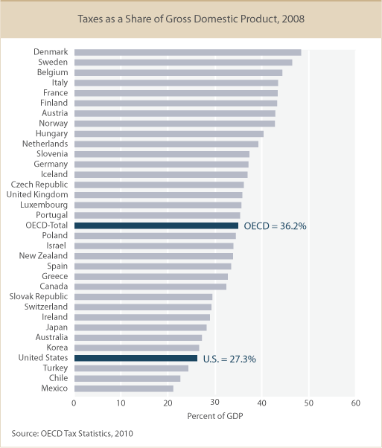
Tax burden as % of GDP
USA has a low tax burden compared to OECD average but:
What is the value of the taxes we pay?
Notes:
Challenges of comparing tax burden - cost of healthcare,, early childhood education and day care, better unemployment compensation, free or low cost college, state pensions

Slide 18
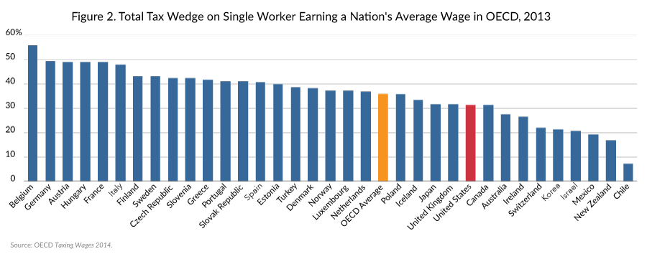
Tax burden on labor
USA has relatively low taxes on labor compared to OECD
Notes:
This includes payroll taxes such as social security, medicare, federal and state income taxes, unemployment taxes

Slide 19
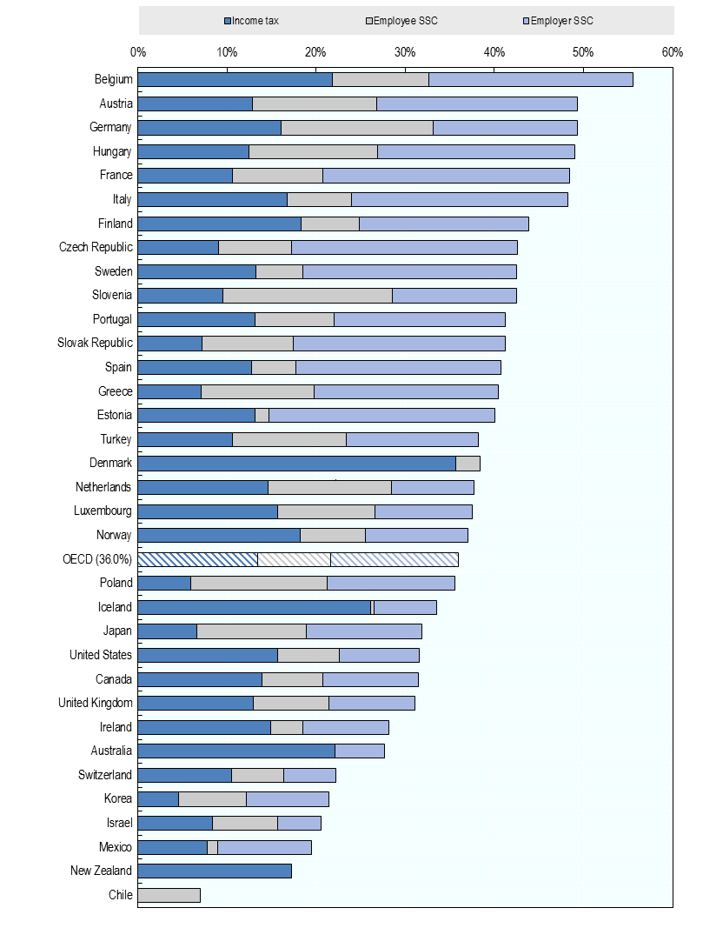
Tax burden on labor
Broken down by employer and employee paid taxes
What happens if we add the out-of-pocket spending (insurance, co-pays, etc) to tax burden?

Slide 20
The Value Question on Taxes: Some top of the envelop numbers
USA
27% of GDP is tax burden
31% tax burden on USA wages (includes Soc Sec taxes, unemployment both individual and employer and 2.3% in medicare tax)
9% of GDP is out of pocket payments on Healthcare in USA
EU5 average tax burden
45% total tax burden on labor
If we add free, or nearly free, early childhood education and daycare, university education as well as more generous unemployment and pensions in EU % ??
More number crunching is needed…

Slide 21
The impact of change in the US Healthcare system
Commonwealth fund the impact of changes in the US Healthcare system
http://www.commonwealthfund.org/interactives-and-data/us-compare-interactive#?ind=3&compare=FR

Slide 22
US Healthcare: Recent Proposals

Slide 23
Obamacare Summary
Offering Americans a number of new benefits, rights, and protections in regards to their healthcare
Setting up a Health Insurance Marketplace (HealthCare.Gov) where Americans can purchase federally regulated and subsidized Health Insurance during open enrollment.
Expanding Medicaid to all adults in many states.
Improving Medicare for seniors and those with long-term disabilities.
Expanding employer coverage to millions of employees.
Requiring most people to have coverage each month from 2014 in order to get an exemption, or pay a fee.
and introducing new taxes and tax breaks, among other provisions.
Subsidized insurance, standards of insurance and personal mandates to broaden access; limited measures to control cost

Slide 24
Republicare or Trumpacare
Repeal Obamacare to eliminate mandates
Allow healthcare insurance sales across state lines as long as policies respect state guidelines to increase competition and lower costs
Allow individuals to fully deduct health insurance premium payments from their tax returns. Review basic options for Medicaid and work with states to ensure that those who want healthcare coverage can have it. (Trump only)
Allow individuals to use Health Savings Accounts (HSAs). Contributions into HSAs should be tax-free and should be allowed to accumulate over a lifetime and passed on to inheritors.
Require price transparency from all healthcare providers
Block-grant Medicaid to the states. States will have the incentives to seek out and eliminate fraud, waste and abuse to preserve our precious resources.
Remove barriers to entry for drug providers that offer safe/cheaper products.
Free market drives down prices, improves quality; access for low income individual dealt with by states

Slide 25
BernieCare
Universal, guaranteed coverage “Medicare for All”
Less complex billing, more transparency
Reduced cost (non profit environment)
No limitations on care
Physicians become gov’t employees
Gov’t control of healthcare investment, procedures, and fees
Premiums and paperwork eliminated
Healthcare as a basic right, ensured by gov’t single payer system

Slide 26
Towards a Framework to Evaluate Healthcare Reform

Slide 27
Moral Imperatives and Practical Concerns
Patients’ decision to use healthcare when elective and to have healthcare when needed
No cost for unnecessary care; yet no access for needed care
Doctors’ and providers’ decision to provide/proscribe healthcare at point of care
Financial incentives for more care; yet efficient, effective quality care
Payers’ decision to approve procedures when submitted
Financial incentives to limit care, yet healthcare for all
The US Healthcare system is misaligned on all these moral imperatives and practical concerns

Slide 28
Moral imperatives, practical concerns
Stakeholders | Incentives any system should reinforce
Patient | Obtain care needed to have a good quality of life; avoid unnecessary care
Provider | Prescribe/offer care for optimal outcomes, quality and service ; do it efficiently
Payer | Approve care to optimize health outcomes ; maximize access while controlling cost
Excellent Healthcare systems need to reinforce these stakeholders incentives in the right direction

Slide 29
Stakeholders and Proposals
Moral Hazard | Obamacare | Republicare | Bernie care
Patient | Increased access but costs and deductibles still limit access | No plan on access; patient out of pocket costs most likely will rise | Universal access, no cost sharing
Provider | Little change in incentives at POC | No change in incentives at POC | Control of reimbursement will control costs other systems elements not addressed
Payor | Does not address cost or limiting of care | Promise of Increased competition might prove elusive | Move to gov’t control will decrease payer moral hazard
Questions/ Comments | Sacred cow of costs, and large stakeholder interest, not addressed | No other HC system in the world uses the market like this | Is it doable in USA? Massive change with resistance!!
Berniecare patterned after EU systems, but can it be implemented?

Slide 30
Other proposals
Steven Brill: mix free market and gov’t regulation
Build on growing concentration in healthcare providers and consolidation of providers and payers to regulate HC as a “natural monopoly” like ATT in the 1960’s
Other Free market ideas
Let technology lead to lower cost by establishing local clinics delivering healthcare “by the rules.” Use less doctors and more technology to delivers care by healthcare works who follow rules for most healthcare issues – eliminate high cost doctors

Slide 31
Summary
Build on the system and culture in the United States
Take single payer systems as model and move US system as close as possible to a single payer system
Use technology as effectively as possible: IT, learning machines improve care and reduce cost
Employ gov’t and public/ private organizations to negotiate fees, procedures and reimbursements so society find the right trade offs…
Healthcare in developed countries is a right;
How can we implement change in the US without stakeholders, with large financial interests in the status quo, dominating the change?

Slide 32
Appendix

Slide 33
Tax burden as % of GDP
USA has a low tax burden compared to OECD average but 2 comments:
What is the value of the taxes we pay?
US tax burden is increasingly support more by individual income taxes
Notes:
Challenges of comparing tax burden - cost of healthcare,, early childhood education and day care, better unemployment compensation, free or low cost college, state pensions

Slide 34
German Healthcare System
Highly regulated system of mainly non profit insurance companies
The average insurance contributions to German sickness funds are based on an employee’s gross income, around 15.5 percent with an income cap at $62,781, and employers and employees each pay about half of the premium. Generally, an individual employee’s contribution is 8.2 percent and the employer pays the remaining 7.3 percent.[57]
Premiums are not based on risk and are not affected by a person’s marital status, family size, or health. Germans have no deductibles and low co-pays.[58]
Doctors are private entrepreneurs and get a fee from insurers for every visit and procedure they perform. However, they are tightly regulated. Groups of office-based physicians in every region negotiate with insurers to arrive at collective annual budgets. Doctors must remain in these budgets, as they do not receive additional funding if they go over. This helps keep health care costs in check and discourages unnecessarily expensive procedures. The average German doctor also makes about one-third less per year than in the U.S., around $123,000.[59]
Government general revenues cover premiums for children, on the premise that the next generation should be the entire nation’s fiscal responsibility, instead of just the responsibility of the parents.[60]
Germany reformed its coverage for prescription drugs in 2010 after costs for prescription drugs continued to rise. Prior to reforms, drug companies set the price for new drugs and were not required to show that the new drug was an improvement over previously available prescription drugs. Pursuant to the reforms effective in 2011, manufacturers could set the price for the first 12 months a new drug is on the market. “As soon as the drug enters the market, a new process of benefit assessment begins.” Manufacturers must establish, through comparative effective research that the new drug has an “added benefit to the patient, compared to the previously existing standard treatment.” Drugs without added benefit will be reimbursed according to a government pricing list. New drugs without added benefits are available to patients, but the patient has to pay the price difference. For drugs with added benefit, a price will be negotiated between health insurers and the manufacturer.[61]
Doctors are self employed, do fee for service but have annual budgets

Slide 35
Singapore Lessons
Lessons from singapore for Anustrailia
https://www.youtube.com/watch?v=x1wslZmTMp0
Key concepts at 6:07 to 10:00 : transparency, economic man
https://www.youtube.com/watch?v=wI2TBPgSxQU&index=29&list=PLAOMWcKiClHR9XX3r-uYwjEvTdviaknHf

Slide 36
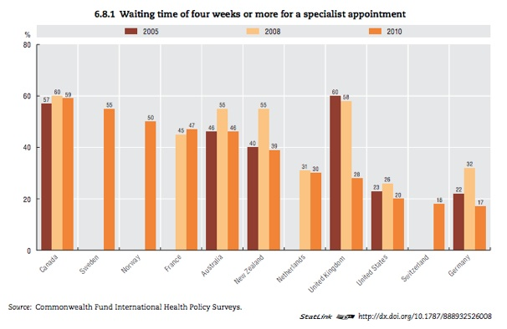
Wait times for Specialists
Most Single payer systems have longer wait times for Specialists

Slide 37
Comparing USA to other systems
This link compares USA systems in terms of outcome to other systems
http://www.commonwealthfund.org/interactives-and-data/us-compare-interactive#?ind=6&compare=FR

Slide 38
French Healthcare: role of gov’t
Provision of healthcare is a national responsibility
Ministry of Social Affairs defines national health strategy
Planning and regulation involve negotiations with provider representatives, the state, and statutory health insurers-
Results of negotiations such as reimbursement rates and fees are passed into law
Central government allocates expenditures: hospitals, ambulatory care, technology ( purchase of CTs, MRIs, building of clinics, etc), mental healthcare, social services, etc.
Regional gov’t is responsible for daily healthcare of the population
Most doctors are self-employed in small practices
Gov’t manages the single payer system;

Slide 39
French Healthcare: coverage
Coverage is universal and compulsory to all residents provided by Statutory Health Insurance (SHI) funds
Gained through employment or granted to those who are unemployed, students and to retired persons
The state covers those who are not eligible: those who have never worked, non residents from EU countries, illegal residents who have applied for residency
Most voluntary healthcare complementary: covering co-payments ( 92% of the population)

Slide 40
French Healthcare: What is covered?
Hospital care, rehabilitation, physiotherapy, outpatient care provided by general practitioners, specialists, dentists and midwives
Diagnostic services, Prescription drugs,
Medical appliances need to be approved
Partial long term care
Some preventative services
National authority and public-private groups recommend adding procedures, drugs and devices to list of reimbursed services

Slide 41
French Cost Sharing
3 forms of cost sharing: coinsurance, co-payments and balance billing leading to 9.6% of spending is out of pocket ( mostly vision and dental work)
Copayments: (before complementary insurance)
Inpatient care 20%, doctor visits 30%, dental care 30%
Annual ceilings: 50 euros for
Inpatient care, doctor visits, ambulance services
No deductibles
“Balanced billing” is allowed: providers can charge more than reimbursement rates but get lower state reimbursement
Voluntary insurance usually pays the difference depending on insurance plan
Healthcare available to all at little or no cost; full choice of doctor with some market mechanisms for highly sought after providers

Slide 42
French HC: financing
64% is financed by employer and employee payroll taxes
16% from national earmarked tax (Impot de solidarite)
12% from revenue from tax on tabacco, alcohol, pharma industry and voluntary insurance companies
8% from state subsidies and transfers

Slide 43
Delivery Overview
Mostly private: 70% of GPs are self employed
50% of specialists are self employed
2/3 of hospitals are public or non profit; 1/3 private for profit
Hospitals reimbursed by DRG systems – capitated system that includes doctor’s salaries.
Some fee for service exists in private hosptials
Balance billing exists = physician fees greater than reimbursement rates

Slide 44
USA system overview healthcare triage
https://www.youtube.com/watch?v=yN-MkRcOJjY&list=PLAOMWcKiClHR9XX3r-uYwjEvTdviaknHf

Slide 45
US Healthcare: role of Gov’t
Affordable Care Act established “shared responsibility” between government, employers and individuals for ensuring that all Americans have access to affordable and quality healthcare insurance
64% have private voluntary insurance (54% thru employers)
Public programs cover 34%: Medicare 16%, Medicaid 17% and military health 5%
Uninsured represent between 20 and 30 million individual
Healthcare is required since 2014

Slide 46
What is covered?
The ACA requires the following 10 services covered:
Ambulatory patient services
Emergency services
Hospitalization
Maternity and newborn care
Mental health and substance abuse treatment
Prescription drugs
Rehabilitation services and devices
Lab services
Preventive and wellness services as well as chronic disease mgnt
Pediatric services including dental and vision care
Private care has provider networks. Dental and long term care are often separate policies
Medicare covers hospitalization, physician services and drug prescriptions but does not cover long term care
Providers can accept or not all insurance programs. Public programs are often refused
Obamacare expanded services covered by setting standards

Slide 47
USA Cost sharing
American spend 12% of all HC spending out of pocket
Cost sharing (deductibles or co pays) vary widely in private plans
Medicare requires co-pays for hospital care, ambulatory care physician services
ACA includes subsidies for those close to FPL, limits deductibles to $2000 (individuals) and $4000(families) for small groups
Cost sharing is capped at $6350 (individuals) and $12700 for families
Medicaid and the Children’ Health Insurance Program (CHIP) provide somewhat of a safety net
US out of pocket spending is up to 5 times higher than peer countries
Co-payments and deductibles used to limit HC spending

Slide 48
USA financing
Gov’t pays 47.6% of HC spending in 2012
Medicare is financed through payroll taxes, premiums, federal general revenues
Medicaid is financed through joint Federal-state funding. Federal financing varies from 50 to 75% depending on state per capita income. Recent ACA expansion is largely funded by Fed.
Private Insurance accounts for 33% of spending
Insurers are profit or not for profit
Regulated by the states
Largely bought by tax exempt premiums paid for by employers and employees; also bought by individuals
Some individual have both public (Medicare) and private insurance
US Healthcare is uniquely characterized by large private, and fragmented, insurance coverage and the resulting complexity

Slide 49
Structure and Delivery of Care
Primary care – 33% of all doctors
Largely in individual and small group practices though large practices with salaried physicians growing as well as ACOs and HBOs
Patient usually have choice of doctor, and usually are not required to register with primary care doctor or nurse
Paid for by negotiated fees for service(private insurance), capitation (private insurance) and administrative set fees ( public insurance)
Usually cannot charge more than negotiated fees
Out-patient specialist care
Both public and private
HMOs often require referrals, while PPOs do not
Medicaid patients have difficult access due to low reimbursement rates
Payment
Co-Payments are made on the spot or later.
Providers bill insurers by coding the services rendered. This process is very complicated and time-consuming.

Slide 50
Structure and Delivery of Care
After hours care
34% of primary care physicians provide after hours care
Emergency rooms and urgent care provide most of the service
Hospitals
70% of beds are non profit, 15% for profit and 15% public in 2012
Paid through fee per service, per diem, per case, or bundled payment where hospital is accountable for outcomes
Most are paid on a fee per service basis: DRG
A growing amount of physicians are salaried but most are paid on a fee per service basis

