Slide 1
Why Does Healthcare Cost so much in the USA?
Michael Teasdale
OLLI
February, 2016

Slide 2
Course Agenda
Date | Topic
Feb 15 | Comparing performance of healthcare systems
Feb 22 | Why does the US system cost so much?
Feb 29 | An overview of other healthcare systems
March 7 | Other Healthcare systems (con’t); policy alternatives
A deep dive into why we pay so much for healthcare

Slide 3
Agenda
Compare US spending with average cost of peer countries
Break down spending into components of Healthcare spending:
Outpatient care
Inpatient care
Drugs
Administration
Long term care and home care
Durables
Identify some takeaways and lessons to use to compare with other systems

Slide 4
Data Sources
McKinsey Study from 2008
OECD data, 2015
Commonwealth Fund Report, 2015
America’s Bitter Pill, Steven Brill
American Association of Hospitals

Slide 5
Summary of Session 1
Cost of US healthcare is what throws the US out of the mainstream: US spent $750 billion more in 2013 compared to peer systems on a PPP basis.
The US System does not provide the value for which we pay
Lack of access and middle of road results for outcomes, quality and service
Financial cost that leads to limited access and worse outcomes than peer countries
US Healthcare spending coupled with lower access are clearly the major issues for the US System

Slide 6
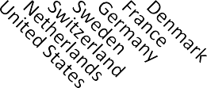
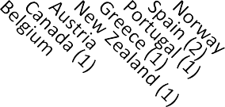
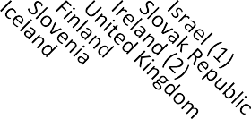
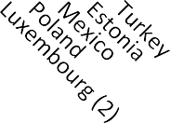
Health spending (excluding investment) as a share of GDP, OECD countries, 2013
Health spending (excluding investment)
Public expenditure
Private expenditure
15.0
10.0
5.0
0.0
1Preliminary estimate.
2Data refer to 2012.
US spends 35 to 50% more than peer countries on healthcare; this amounts to $750B in overspending (PPP) in 2013
Notes:
largest private spending on HC on per capita and % basis PPP – parity purchaing power – not just an exchange rate but more a comparison of what the local currency will buy you.. Comparing what you get for a dollar with what you get for a euro….

Slide 7
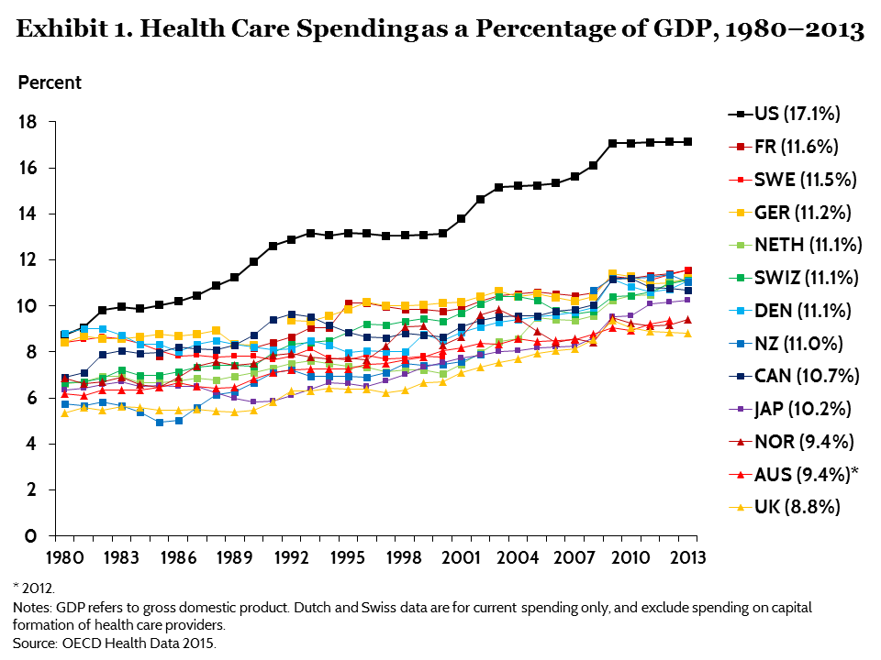
OECD HC spending Since 1980
HC Spending in the USA skyrockets from 1980 on
Notes:
USA 1047 per resident out of pocket – only swiss spent more and the french spent 270
-puclic spending in USA more than all except Nor and Netherladn only w/o national healthcare system; private insurance is 5 times the cost in the nxt country - canada: $3442 per capita and $654 in canada

Slide 8
Healthcare Spending in USA
Spending in Billions, 2006
USA spends more on Healthcare than on food and all of Chinese consumer spending

Slide 9
Deep Dive into Healthcare Spending in the USA
Why do we spend so much for mediocre quality and limited access to Healthcare?

Slide 10
USA over spends $650B on HC (2006)
$650B
% GDP spent on HC
2006 est.
Estimated Spending According to Wealth (ESAW)
A McKinsey metric used to help compare spending across countries
It adjusts healthcare spending according to per capita GDP and purchasing power (PPP)
It includes 13 countries: Austria, Canada, Czech Republic, Denmark, France, Finland, Germany, Iceland, Poland, Portugal, South Korea, Spain, Switzerland
Includes the tendency to spend more on HC as wealth increases

Slide 11
Components of Healthcare
Outpatient care: includes: all same day visits in hospitals, including ED, all visits to physicians’ offices, all care provided at ASC and DICS, all dental visits, mental health, etc
Inpatient care
Drugs, Durables
Health Administration and Insurance
Long term care
Investment

Slide 12
US Spending on HC by Component, 2006
2006 spending McKinsey, 2008
Outpatient Care is biggest component in US HC spending

Slide 13
Spending above/below ESAW by Component
% Spending above ESAW
$650B
Below ESAW
Outpatient care accounts for $436b of $650b in excess spending in 2006
Notes:
Outptient care includes: all same day visits in hospitals, including ED, all visits to physicians offices, all care provided at ASC and DICS, all dental visits

Slide 14
Outpatient Care Spending
Outpatient Care includes
Physician services (office visits)
Dental services
Same day hospital care including elective surgery (ASCs), DICs and ED care
Other outpatient ( non-physician care, drug rehabilitation clinics, mental health clinics, etc.)
$436 B
Outpatient care represents 40% of spending…
…but 68% of spending above expectations

Slide 15
Outpatient Share of Patients
USA has high percentage of Outpatient care vs peer countries

Slide 16
USA Shift to Outpatient Care leads to Savings
Inpatient Hospital days per year
Per 1000 population
43% less in USA
McKinsey, 2008
130 million bed days less / year
$750-925 per day additional cost for inpatient stay
$100 -120B savings due to Shift to outpatient care
$100 to 120 Billion savings estimated with greater use of outpatient care
but …

Slide 17
But savings only represent a fraction of addition spending
Healthcare spending
$ billion, 2006
Spending above ESAW
Savings
McKinsey, 2008
That $120B savings is a only fraction of $436B in above expected spending. Why are we spending so much on Outpatient care?

Slide 18
Outpatient spending
The structure and incentives align for increasing outpatient care spending
Cost per procedure is much higher in USA

Slide 19
USA outpatient care
Outpatient care is more frequent in the USA than in most other developed countries (only Portugal and Canada has greater percentage of care in outpatient)
Outpatient care often drives quicker recovery times
And lower cost for equivalent procedures than in-patient care
Yet outpatient care is driving most of the overspend for HC in USA
Incentives for the industry are aligned to do more healthcare, not quality healthcare
Reimbursement structure does not drive efficiency - fee for service drives outpatient profits and growth
Growth in supply of outpatient assets led to growth in outpatient procedures
Outpatient care reimbursement is often not capped;
revenues per visit in outpatient care are rising

Slide 20
Outpatient Care has higher margins
Hospital Revenue and EBITA by margin and type of care
Percentage
Elective outpatient care represents 75% of hospital margins ….
…yet only 24% of revenue
Notes:
EBITA means Earnings Before Interest, taxes and Amortization
ED care important to leverage fix cost and a major source or referals for elective surgery

Slide 21
Hospital focus on out patient care for new opportunities
Providers have focused investment in, and
growing the supply of, out patient care facilities and procedures

Slide 22
Distribution of Outpatient vs. Inpatient Revenues, 1993 – 2013
Gross Inpatient Revenue
Gross Outpatient Revenue
Source: Avalere Health analysis of American Hospital Association Annual Survey data, 2013, for community hospitals.
Hospital outpatient revenue continues to grow as % of revenue: 40% in 2013

Slide 23
Economic Questions on Cost and Healthcare…
Greater supply of facilities and resources has driven procedure volume growth and spending growth; Supply growth leads to demand growth
Increasing vertical integration of healthcare (mis)aligns incentives
New technology has also led to more spending and higher cost. Normally new technology leads to lower cost and higher productivity or more service (Electronic industry, etc..)
Why is this the case?
Information asymmetry and moral hazards
Price insensitivity and the promise of greater benefits
Inelastic demand
Health care sector does not fit conditions for free market mechanisms
Notes:
Specialist 6.5 times capital GDP; OECD ave is 3.9; generalist 4.1 times per capital GDP and Oecd ave is 2.8

Slide 24
Information Asymmetry
Information Asymmetry:
Definition: In contract theory and economics, information asymmetry deals with the study of decisions in transactions where one party has more or better information than the other. This creates an imbalance of power in transactions, which can sometimes cause the transactions to go awry, a kind of market failure in the worst case
Physician judgement is a key driver for care decisions – yet economic rewards (reimbursement) and legal environment incentivize more care (physicians profit from owning devices and perform services for fees, that they proscribe.)
Stark laws make various exceptions for self referrals within the medical world so providers of care are incentivized by fee for service structure and vertical integration
Fear of litigation drives over care and potential waste….
“Moral hazard” for doctors in care decisions
lead to a failure of classical market mechanisms
Notes:
Stark laws effective in 1992 were intended to prohibit physician for rerefering patients for services to entities in which they have a financial stake. The aw has been updated since and exception have been made to allow referals to physicians in the same practice, in office ancillary services and referals to entities in which the physician in invested

Slide 25
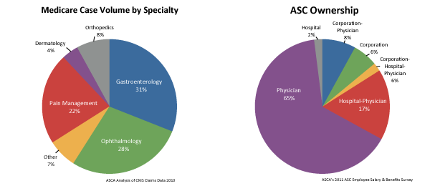
ASC Ownership and Care Specialty
Vertical integration of provider networks
Physicians own “stream of care” from devices in office to local ASCs
Local Hospital chains are increasing buying physician practices and ASCs (Ambulatory Surgery Centers) and DICs (Diagnotic Imaging Centers)
Ownership is changing but incentives are the same.
Economic incentives lead to moral hazard for providers in the dominantly fee for service environment of outpatient care

Slide 26
Price Insensitivity and Inelastic Demand
Patient price insensitivity –
Patients do not see immediate price and often pay 15% of cost in the USA (co-pays, deductibles…etc)
Delayed and indirect payment system (insurance rate increase not associated with increased care)
Promise of greater benefits with new procedures, drugs or technology
Nearly Inelastic demand
Life or death, or quality of life, concerns drive medical health decisions
Technology promises greater benefits to these decisions
Reimbursement rates are high for new technology
“Moral hazard” for patients in care decisions
lead to a failure of classical market mechanisms

Slide 27
Structure Outpatient Summary
With the promise of healthcare benefits and more efficient care, increased outpatient care has led to greater spending and apparently no major healthcare outcome benefits (perhaps some service benefits)
Due to great profitability in outpatient care, providers invested in capacity and demand grew parallel to these investments
Market mechanisms that might effect pricing and demand do not work in healthcare due to
Information asymmetry and incentives embedded in the structure of healthcare in the USA to delivery more care
Price insensitivity = patients have only long term or non direct impacts, yet get greater benefits for new technology
Nearly inelastic demand or outright inelastic demand frequent in the healthcare and the promise of technology
Greater Supply = Greater Demand = Greater Spending

Slide 28
Outpatient spending investment and cost
Technology innovation, reimbursed at higher rates and used more often in USA , lead to more spending: Growth of ASCs and DICs
Physician fees and mix are higher than in peer countries
Private payors do not seem to be able to control reimbursement levels
Volume of care is rose but also cost per procedure
is disproportionately high in the USA

Slide 29
Drivers for Outpatient care
Outpatient Spending Growth 2003-6
Growing use of freestanding ASC and DICs due to convenience, capacity growth of 7 to 8%
Volume and revenue per visit for outpatient care grew due to tech use (CTs, MRIs, etc) and other technology
Physician compensation drives cost per visit rise of 8%; specialists are getting larger share of visits
$850B total Spending
Includes $75B in ED care
OECD, McKinsey data
Same day care, ASC, DICs and physician office care drive lion’s
share of absolute spending and growth
Notes:
7% growth in revenue per visit; outpatient care very profitable, and is often driven by physician judgement and elective procedures or diagnostic procedures; newer technology does not drive lower cost but usually increased cost and reimbursement; patients are price insensitive

Slide 30
More Ambulatory Surgery Centers (ASC) and Diagnotics Imaging Centers (DIC) in USA care
ASC and DICs growth have driven usage to levels far above peer countries.
Diagnostic Imaging use in the USA is 30 to 50% higher and cost is 30 to 50% more than in peer countries
Usual market mechanisms, such as greater competition leading to lower pricing has not happened, prices have increased and greater spending has resulted

Slide 31
DICs: Exams per 1000 pop
ª 2012. ^{b} 2011. ^{c} 2010.
Source: OECD Health Data 2015.
The USA has between 35 to 50% more scans per 1000 population
than peer countries

Slide 32
Average Prices for MRI, CTs
ª Source: International Federation of Health Plans, 2013 Comparative Price Report.
Prices for MRIs and CT are from 50% to 300%
higher than in peer countries

Slide 33
Growth of ASCs
Migration from in patient facilities due to convenience and new technology
Financial incentives for physicians for both building and using ACSs
Regulatory changes ( Stark laws)
Improved anesthesia procedures
Enhanced instrumentation: endoscopy, laparoscopy and other minimally invasive surgery
Rapid Growth of ASCs and DICs is a uniquely American phenomena and has led to more procedures

Slide 34
Surgery done in Outpatient
% of total surgeries performed
year
Reportlinker .com
Volumes of procedures in Outpatient have increased while volume of inpatient surgeries have remained flat

Slide 35
Cost of Physician Services
US spends $64B more than peer countries due to cost of physicians
Americans do not visit physicians more but each visit is more expensive
$40B of cost overspend is in Outpatient care due to high use of specialists
Higher physician fees and salaries in the USA are in part driven by “externalities”

Slide 36
Physician Supply and Use, 2013 or Nearest Year
Practicing physicians per 1,000 population
Annual physician visits per capita
Source: OECD Health Data 2015.
Addition spending due on Physicians is not a question of volume

Slide 37
Comparative Physician fees
Primary Care Physician Fees
Orthopedic Physician Fees for
Hip replacement
US Physician fees generally higher, cost increased also by bigger percentage of private payers in US healthcare system, and higher percentages of visits to specialists

Slide 38
Physician salaries
Physician salaries as multiple of average salary in the country
Higher Physician earnings add $64B to expected cost of US healthcare
Shift to more use of specialists in outpatient care
$40B of salary overspend is in outpatient care
Multiple of median wage
Partial explanation for higher salaries:
Higher costs of medical education
Legal fees
Opportunity cost of not entering another profession
….explain difficulty to change healthcare
Notes:
2008 medical school cost average 32000 in USA 10 to 11K in UK and free in France

Slide 39
Public vs Private reimbursement for MRIs
Private Payors struggle to keep costs down
Demand grows in lockstep with installed base
Improvement in technology result in even greater volume of MR/CT usage
Despite increasing supply, Medicare reimbursements grew at 1% per year
Private insurance reimbursements are even larger
Pushed by the promise of new technology and inelastic demand, market mechanisms have not worked. Growing provider strength might also play into rising costs

Slide 40
Outpatient $436b in surplus spending
Structure of Outpatient care:
originally to control costs and improve convenience, outpatient has led to an increase in volume of care
Provider investment built supply due to attractive profits for outpatient
Providers, influencing demand and due to vertical integration, filled this volume with growing demand
Cost per procedure and Mix
In addition to volume of care, spending per procedure is high in US due to technology use and salaries
Private payors have not controlled spending in outpatient care
A perfect storm of (mis)aligned incentives and the unique nature of healthcare transactions lead to excessive spending

Slide 41
In Patient Care

Slide 42
Spending above/below ESAW by Component
% Spending above ESAW
$650B
Below ESAW
Inpatient care accounts for $40b of $650b in excess spending in 2006
Notes:
Outptient care includes: all same day visits in hospitals, including ED, all visits to physicians offices, all care provided at ASC and DICS, all dental visits

Slide 43
Inpatient care
Costs 25% of overcall healthcare cost in USA
But only 6% of overspend – $40B in 2006
USA has lower rates of admission in inpatient than peer countries due to shift to outpatient care
Inpatient reimbursement mechanisms create incentives for efficient care (capitation limiting length of stay, etc)
Yet higher patient-per-day costs - more than double of peer countries - offset these efficiencies
Data shows private has not controlled costs

Slide 44
Hospital Supply and Use, 2013 or Nearest Year
Acute care hospital beds per 1,000 population
Hospital discharges per 1,000 population
Source: OECD Health Data 2015.
Greater usage of inpatient or hospital stays is not the source; Potential lack of supply or local monopolies could actually drive prices higher

Slide 45
US Inpatient care saves money on LOS and volume
179
$100B to 120B saved each year due to Length of stay and number of admissions per thousand

Slide 46
Prices for Hospital and Physician’s Service
Ave prices in thousands
ª Source: International Federation of Health Plans, 2013 Comparative Price Report.
USA in patient procedures often more than double of the cost in peer countries

Slide 47
Hospital Spending per Discharge
Average Spend per discharge
USA pays 33% more than next most expensive peer country (Canada)

Slide 48
Prices for Hospital Delivered Pharmaceuticals
% of USA Prices
ª Source: International Federation of Health Plans, 2013 Comparative Price Report.
USA pays often pays the double for pharmaceuticals delivered in hospital

Slide 49
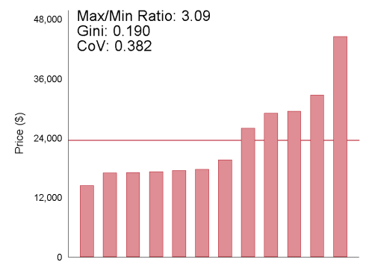
Private Payor Reimbursment
Knee Replacement in Denver Private Prices 2008-2011, Cooper, Graig, Reenan and Gaynor, 2015
Private Payors pay 3 fold difference in one market

Slide 50
Reimbursement prices and hospital concentration
Health care spending per privately insured beneficiary varies by a factor of three across the 306 Hospital Referral Regions (HRRs) in the US for the same procedure
Second, variation in providers’ transaction prices across HRRs is the primary driver of spending variation for the privately insured, whereas variation in the quantity of care provided across HRRs is the primary driver of Medicare spending variation.
There is large dispersion in overall inpatient hospital prices. For example, hospital prices for lower-limb MRIs vary by a factor of twelve across the nation and, on average, two-fold within HRRs.
Finally, hospital prices are positively associated with indicators of hospital market power. Even after conditioning on many demand and cost factors, hospital prices in monopoly markets are 15.3 percent higher than those in markets with four or more hospitals.
Growing concentration in providers (hospital groups) is leading to higher prices

Slide 51
Percentage of Hospitals with Negative Total and Operating Margins, 1995 – 2013
Negative Operating Margin
Negative Total Margin
Source: Avalere Health analysis of American Hospital Association Annual Survey data, 2013, FOR hospitals.
Hospitals systems have seen lower negative margins except for 2013
Are hospitals gaining strength?

Slide 52
Aggregate Total Hospital Margins⁽¹⁾ and Operating Margins,⁽²⁾ 1993 – 2013
Source: Avalere Health analysis of American Hospital Association Annual Survey data, 2013, for hospitals.
⁽¹⁾ Total Hospital Margin is calculated as the difference between total net revenue and total expenses divided by total net revenue.
⁽²⁾ Operating Margin is calculated as the difference between operating revenue and total expenses divided by operating revenue.
Except for 2008 crisis year aggregate hospital margins are increasing

Slide 53
In patient care Summary $40b in additional spending
Despite lower amount of stays and shorter lengths of stay, overall spending is higher
This is driven by greater cost per procedure and greater cost of hospital stays
Payors, especially private payors, have struggled to control reimbursement
Provider local bargaining power seem to have increased due to growing concentration in providers in local markets
Notes:
The data for 2013 show that the providers' expenses increased at an annual rate of 4.6%, outpacing their 4.1% annual revenue growth. As such, operating margins and operating cash flow margins declined across the sector; the median operating margin fell to 2.2%

Slide 54
Steven Brill on healthcare industry
http://content.time.com/time/video/player/0,32068,2178453595001_2136781,00.html

