Slide 1
Comparative Healthcare Systems
Explore the US Healthcare System and compare it with other Healthcare Systems to identify what can we learn
Michael Teasdale
OLLI
Notes:
Tell about why the class ; good data and fascinating results ; not an expert so I wish others in the room who have experience can speak… we all have personal stories

Slide 2
Objectives of this course
Compare the performance of USA health system with others to build an understanding of the relative quality of the US healthcare system
Explore if the USA is getting optimal value from its Healthcare System by analyzing cost, service, access and outcomes
Explore why does the US system cost so much and identify the drivers of high HC cost in the USA
Explore other Healthcare systems structure and mechanisms
Draw lessons and apply them to current proposals for change
Notes:
Mention taster objectives and how they relate to course; root causes of cost inflation

Slide 3
Course Agenda
Date | Topic
Feb 15 | Comparing performance of healthcare systems
Feb 22 | Why does the US system cost so much?
Feb 29 | An overview of other healthcare systems
March 7 | Other Healthcare systems (con’t); policy alternatives

Slide 4
Today’s Road Map
What is a healthcare system? How do they develop?
Comparing Healthcare Systems
Comparative Cost
Comparative Service and Access
Comparative Quality and Outcomes
Does the USA healthcare system delivery Value?
Some key data to provide a quantitative overview and analysis

Slide 5
Data Sources
Organization for Economic Cooperation and Development (OECD)
Healthcare Status Report, 2015
Healthcare Quality Indicators Project, 2014
World Heath Organization (WHO), various papers and data
The Commonwealth Fund Survey, 2006, 2010, 2015
McKinsey Report on Healthcare Spending in USA, 2008
Various articles - Atul Gawande (New Yorker), Time magazine (Steven Brill), Lancet

Slide 6
Limits to Data and HC comparability
Limitations of Measuring Health Care System data due to data definition and robustness: cultural differences, definitions of data, adjustments for acuity or severity or lack thereof, etc.
Confounding factors: educational levels, environmental hazards, housing, nutritional status and diet, homicide rates, lifestyles
Adversely affected by new disease (e.g. HIV/AIDS) or civil unrest
Despite issues with data, major trends appear
with some confidence

Slide 7
Definitions of a Healthcare System
The combination of healthcare institutions, supporting human resources, financing mechanisms, organizational structures that link institutions, information systems, and resources and management structures that collectively culminate in the delivery of healthcare services to patients – Lassey, Lassey and Jinks
Healthcare systems permeate society and represent a large part
of the economy: We ain’t just talking hospitals, nurses and doctors
Notes:
See page 3 and 4 in Lassey for first definition; 2nd is in Johnson and Stoskopf

Slide 8
National Environment and Healthcare
All healthcare systems function in a physical, economic, historical and cultural environment
General physical environment and climate
Socio-economic factors: income levels and distribution, education and knowledge of hygiene
History and historical values - a sense of “solidarity” or individualism
Political and cultural ideals expressing norms and values
Cultural, Family and Individual factors: personality, genetic make-up, life style, diet, use of tobacco, alcohol use, exercise, mental health, etc.
Healthcare Systems are born from their environment and history
Notes:
Seepage 4 ,5 and 6 in lassey
Climate and weather malaria issues; high incomes , highed education= longer lifetime; English sense of solidarity led to HNS

Slide 9
Healthcare Systems and their Origins
Britain: solidarity and WWII
Tradition of hospitals funded by altruistic individuals or workhouses (1834) funded by local taxes, then compulsory trade union or fraternal societies coverage (prepaid health plans); slow evolution to government funded (Downton Abbey) first locally
Burden of care for wartime casualties led to the creation of a national system made law by National Health Service Act in 1948
France: egalitarianism and liberalism (free market)
Medical profession built charters and standards of care 1927
Nation health insurance laws of 1928/1945/1967 built on local tradition of local sickness funds, established by guilds and professional organizations
French system continues a mix of private and public system.
USA: individualism and the need attract workers
Large hospitals, largely funded by charity; Private HC company 1848
Private insurance(“the Blues”) becomes prevalent in the 1930’s and 40’s
Need to attract workers during WWII led to employee sponsored plans and they became tax deductible if employee sponsors
Efforts at a universal insurance have been defeated on numerous occasions
Notes:
See article by Atul Gawande in New Yorker 2009
Evolution of workhouses into hospitals

Slide 10
Healthcare systems: inputs and outputs
Inputs
Culture: norms and values, political attitudes
Patients: education, socio-economic level, diet, disease prevalence and acuity, age
Healthcare System
Hospitals, clinics and other institutions
Financing, Insurance
Outputs
Quality/ Outcomes
Doctors, nurses, etc.
Education of healthcare workers
Transportation
Environment and climate
Religion
Laws pertinent to the delivery and payment of care
Service/ Access
Cost
Technology
Our comparison between systems will focus first on Outputs

Slide 11
Comparing Healthcare Systems
Cost
Outcomes and Quality
Service and Access
VALUE

Slide 12
Life Expectancy and Wealth are Correlated
http://www.gapminder.org/world/#$majorMode=chart$is;shi=t;ly=2003;lb=f;il=t;fs=11;al=30;stl=t;st=t;nsl=t;se=t$wst;tts=C$ts;sp=5.59290322580644;ti=2013$zpv;v=0$inc_x;mmid=XCOORDS;iid=phAwcNAVuyj1jiMAkmq1iMg;by=ind$inc_y;mmid=YCOORDS;iid=phAwcNAVuyj2tPLxKvvnNPA;by=ind$inc_s;uniValue=8.21;iid=phAwcNAVuyj0XOoBL_n5tAQ;by=ind$inc_c;uniValue=255;gid=CATID0;by=grp$map_x;scale=log;dataMin=194;dataMax=96846$map_y;scale=lin;dataMin=23;dataMax=86$map_s;sma=49;smi=2.65$cd;bd=0$inds=;example=75
As a general rule, Health, measured by life expectancy,
increases with greater wealth

Slide 13
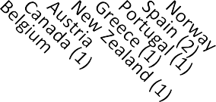
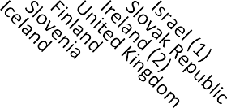
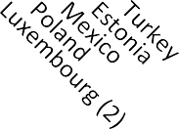
Health spending (excluding investment) as a share of GDP, OECD countries, 2013
Health spending (excluding investment)
Public expenditure
Private expenditure
15.0
10.0
5.0
0.0
1Preliminary estimate.
2Data refer to 2012.
US spends 35 to 50% more than peer countries on healthcare; this amounts to $750B in overspending (PPP) in 2013
Notes:
largest private spending on HC on per capita and % basis PPP – parity purchaing power – not just an exchange rate but more a comparison of what the local currency will buy you.. Comparing what you get for a dollar with what you get for a euro….

Slide 14
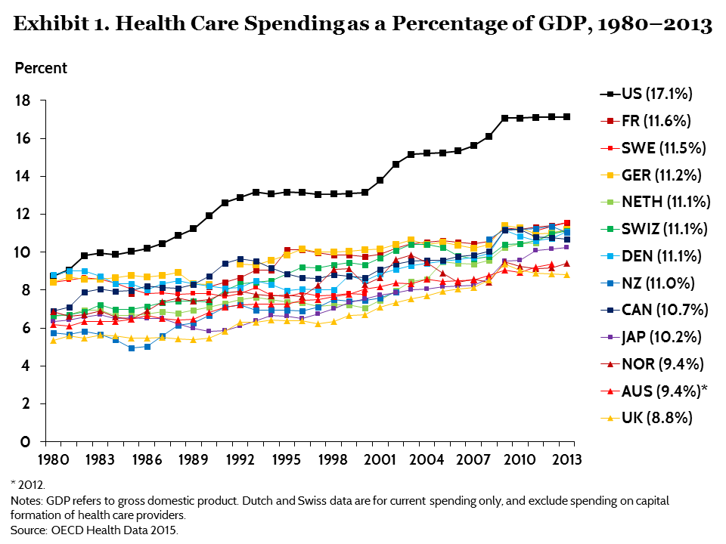
OECD HC spending Since 1980
HC Spending in the USA skyrockets from 1980 on
Notes:
USA 1047 per resident out of pocket – only swiss spent more and the french spent 270
-puclic spending in USA more than all except Nor and Netherladn only w/o national healthcare system; private insurance is 5 times the cost in the nxt country - canada: $3442 per capita and $654 in canada

Slide 15
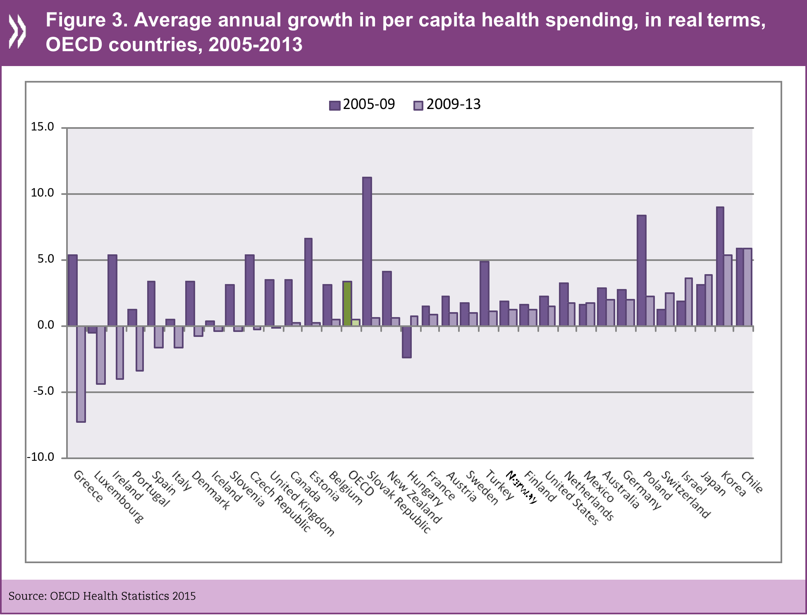
Healthcare spending growth is slowing worldwide
US HC spending growth slows along with most Developed Countries

Slide 16
Out of Pocket Per Capita HC Spending
*Includes insurance and durables (wheel chairs, etc.)
OECD 2015, PPP $
US Residents spend more than 5 times what the next highest country spends for insurance and other out of pocket spending

Slide 17
Global (OECD) HC Spending by Components
Outpatient and long term care remain fastest growth components
Notes:
Is this all OECD?

Slide 18
Public Spending and Public Coverage
 | Percentage of population covered by public funds | Public spending per capita in $
USA | 34 | 4197
UK | 100 | 2802
WHO, 2014
US public spending covers a smaller population in percentage terms and costs more

Slide 19
Healthcare Cost Takeaways
USA HC System is up to 50% more expensive than peer countries as a % of GDP
For estimated $2.8 trillion spent in 2013, we overspent $750 billion on PPP basis
The spending gap between USA and other countries has widen since 1980
Out of Pocket costs in the USA are multiple times higher than in other developed countries on PPP basis
Healthcare spending growth since 2009 seems to be slowing
USA – High Cost Country for HC
Notes:
PPP = Purchasing Power Parity

Slide 20
Comparing Healthcare Systems
Cost
Outcomes and Quality
Service and Access
VALUE

Slide 21
Commonwealth Fund Survey on Sicker Adults
Sicker adults randomly chosen among those who
Claimed fair or poor health
Had a serious illness, chronic illness, major surgery or major hospitalization in last 2 years
Participants in the survey
700 to 750 in New Zealand, Australia and Canada
Over 1500 in US, UK and Germany
2005-6 survey

Slide 22
Access to care: Wait time to see a Doctor
% patients answering “yes”
Commonwealth Fund
Survey, 2006
USA wait times to see a Doctor for sicker adults
mixed when compared with peer countries
Notes:
Total for USA to see a doc – higher is better

Slide 23
Wait times for Elective or non emergency surgery
% patients answering “yes”
Commonwealth Fund
Survey, 2006
USA wait times for elective surgery relatively short
vs peer countries
Notes:
UK and Canada struggling… High lit blue good; low dark bad….

Slide 24
Coordination Problems with one or more Doctors
% patients answering “yes”
Commonwealth Fund
Survey, 2006
USA has more issues with coordination
With care among 4 or more doctors
Notes:
Within last two years

Slide 25
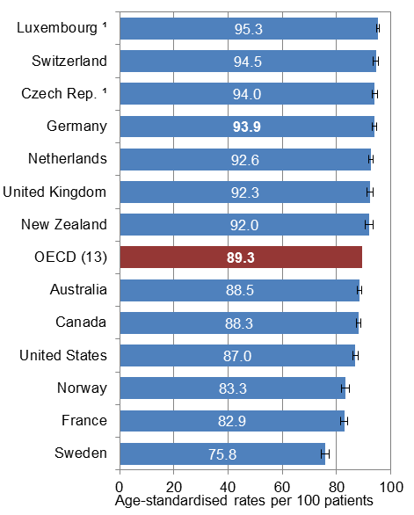
Doctors and Patients
Regular Doctor providing easy
to understand explanations
Regular Doctor giving enough time to ask
questions and raise concerns
Commonwealth Fund Survey, 2010
USA in lower half of OECD countries
surveyed on Doctor / patient relations

Slide 26
Most OECD countries have achieved 100% coverage
OECD 2013, except for US numbers are for 2014
USA, Mexico and Estonia remain laggards in coverage numbers
despite first year of Obamacare ( ACA)
Notes:
2014 data for USA includes first year of Obamacare

Slide 27
Healthcare Insurance in the USA
Percent
80
Private
70.0
60
40
20
Uninsured
18.6
12.9
Public
0
1997
2000
2003
2006
2009
2012
2015
(Jan–Sep)
NOTE: Data are based on household interviews of a sample of the civilian noninstitutionalized population. SOURCE: CDC/NCHS, National Health Interview Survey, 1997–2015, Family Core component.
28.8 million persons of all ages (9.1%) were uninsured at the time of interview in 2015 —7.2 million fewer than in 2014 and 16.0 million fewer than in 2013.

Slide 28
Type Healthcare Insurance Coverage in USA, 2014
All Americans
Of those insured
CDC National Healthcare Survey, 2014 (some respondents had two sources insurance)
Private HC Insurance covers around 50% of all Americans

Slide 29
Limited Access due to out of Pocket Cost
51% of patients w/ limited access
% patients answering “yes”
Commonwealth Fund
Survey, 2006
USA patients’ access most affected by out of pocket costs

Slide 30
Amenable Mortality Rate in OECD Countries
Age standardized rate per 100,000 population in 2007, or last year available
OECD Health Working Papers, 2011
USA has a high rate in “treatable” deaths (death avoidable if proper healthcare was available)
Notes:
Mortality rate information: Nolte and McKee consider that all deaths from respiratory diseases between 1 and 14 years are
preventable by appropriate and timely treatments. A limit of “under 15” was set as deaths other
Circulatory diseases were leading cause of amenable disease in OECD 51% of deaths, Cancer accounted for 33% pf amenable deaths in list; USA is slow in making progress in this metric Amenable death have delcined 1.8% since 1997, below the OECD average
Low rates of amenable death in cancer and diseases of the nervous system in USA
Amenable mortality is generally defined as premature deaths that should not occur in the presence of
effective and timely care. It takes into account premature deaths for a list of diseases, for which effective
health interventions are deemed to exist and might prevent deaths before a certain age limit (usually 75,
though sometimes lower).
than in childhood from these causes are likely to reflect some other diseases process (Nolte and
McKee, 2004). Tobias and Yeh consider deaths from chronic obstructive pulmonary diseases
(COPD) only after 45 and deaths from asthma only before 45 as amenable to health services.

Slide 31
Healthcare Service/Access Takeaways
USA, despite excellent numbers for elective surgery wait times, is in the middle of the pack or lagging in some key service measures
Healthcare Insurance coverage remains low in the USA with the USA having one of the highest rates of private coverage
This low and uneven coverage seems to result in out of pocket costs limiting people’s access to care
Among OECD countries, the USA ranks high in avoidable deaths due to lack of care
USA has mixed performance on service and very low performance on access, resulting in higher avoidable deaths

Slide 32
Comparing Healthcare Systems
Cost
Outcomes and Quality
Service and Access
VALUE

Slide 33
Broad Measures of USA Health not Encouraging
Commonwealth Fund Survey, 2006
Comparatively, USA: low life expectancy,
…and high infant mortality rates
Notes:
OECD Healthcare 2015
Recent data on middle aged white men whose life expectancy is going down…

Slide 34
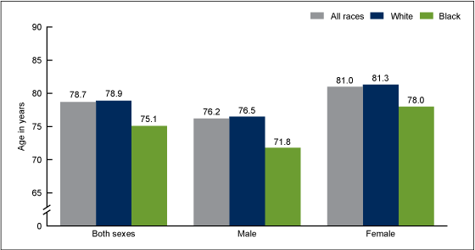
USA: Life Expectancy by Race and Sex
Life expectancy at birth, by race and sex: United States, 2010
SOURCE: CDC/NCHS, National Vital Statistics System, Mortality.
Difference in life expectancy is significant by race and sex but..

Slide 35
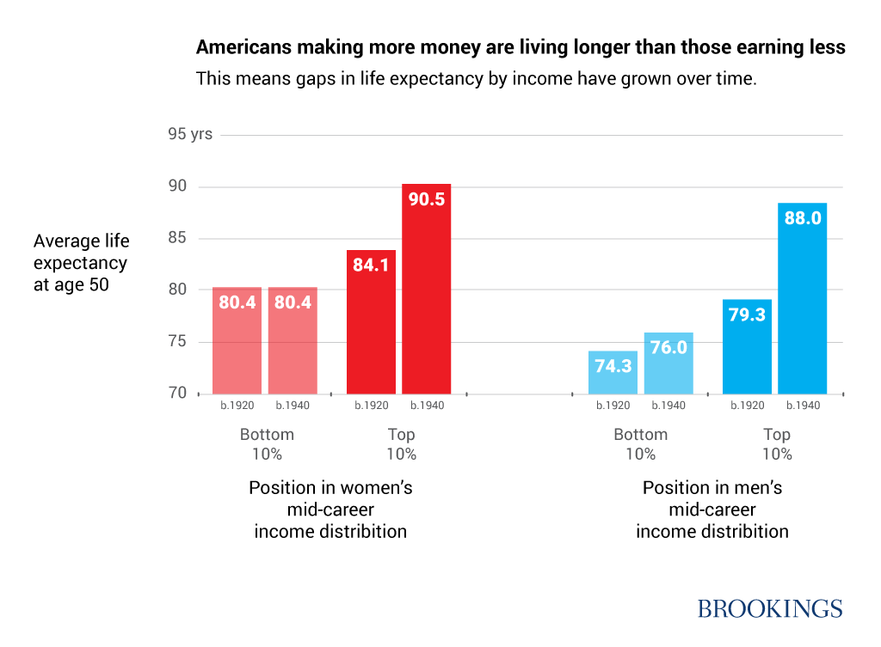
Is dwarfed by Differences in life expectancy by income level
Affluent men and women show big increase in life expectancy, low wage populations stagnant

Slide 36
Infections and Readmissions
Infections While in Hospital
% patients answering “yes”
Readmitted or ER due to complications
Commonwealth Fund
Survey, 2006
USA in the middle of the pack for Infections and Readmissions
Notes:
Commonwealth fund Survey 2005

Slide 37
Medical or Test Error in last 2 years
Patients reporting errors with last 2 years
% patients answering “yes”
Of these errors % occurring outside the Hospital
Commonwealth Fund
Survey, 2006
Late or mislabeled test results, doctor files most cited as issues

Slide 38
Chronic Care (high is good)
Commonweath study 2011-2013
Quality of Diabetes and Hypertension care Middle of the Road In USA
Notes:
hemoglobin A1c checked in past six months, and feet examined, eyes examined, and cholesterol checked in past year.

Slide 39
Chronic Care (high is bad)
Quality of Chronic care is Mediocre in USA

Slide 40
Lower Extremity Amputations as a Result of Diabetes, 2011
Amputations per 100,000 population
* Data from 2010 for the Netherlands, Switzerland, and the U.S.; and 2009 for Denmark.
Source: OECD Health Data 2015.

Slide 41
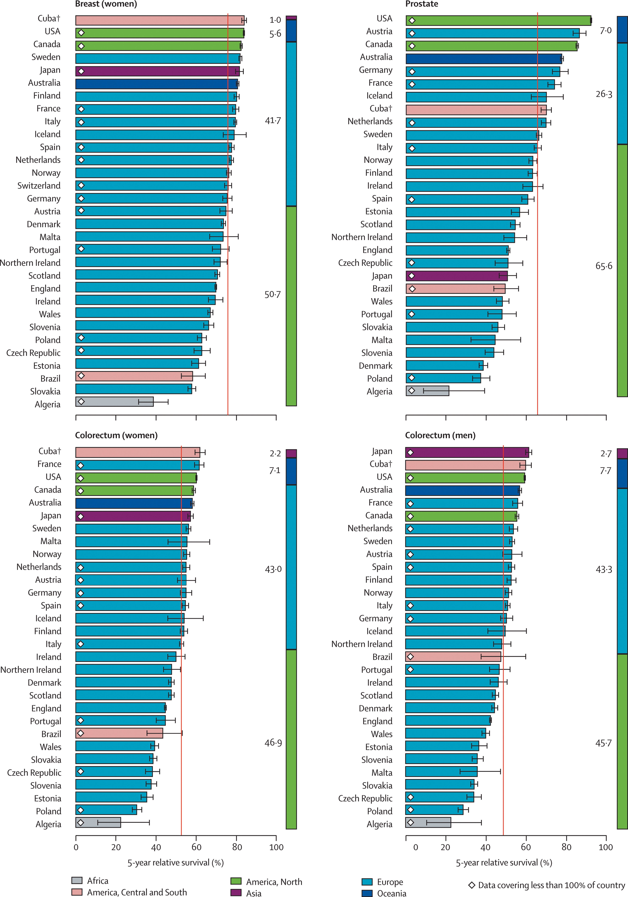
5 year survival rates for Cancer
USA near the top for Breast, Prostate and Colorectum
survival rates

Slide 42
Mortality as a Result of Cancer, 1995 to 2007
Deaths per 100,000 population (adjusted)*
* Mortality rates are adjusted for likelihood of death from other causes.
Source: W. Stevens et al., “Cancer Mortality Reductions Were Greatest Among Countries Where Cancer Care Spending Rose the Most, 1995–2007,” Health Affairs, April 2015 34(4):562–70.

Slide 43
Mortality as a Result of Ischemic Heart Disease, 1995 to 2013
Deaths per 100,000 population
* Data from 2012 for Denmark and Switzerland; 2011 for France, Canada, Australia, and New Zealand; and 2010 for the U.S.
Source: OECD Health Data 2015.

Slide 44
Healthcare Quality/Outcomes Takeaways
From the broad measures of HC systems US performance is mediocre to underperforming (Life expectancy and Infant mortality)
More precise measures of outcomes and quality are mixed (and difficult to assess) with some islands of excellence in outcomes (Cancer, breast cancer, etc.)
USA has very mixed performance in comparison with other developed countries

Slide 45
Comparing Healthcare Systems
Cost
Outcomes and Quality
Service and Access
VALUE?
Are we getting the value from the additional money we spend on Healthcare?

Slide 46
Strengths of US HC System
Innovation and rapid adoption of new technology, new drugs and new processes
Premium Healthcare institutions: top hospitals (John Hopkins, Mayo clinic, academic medical centers, etc. ), medical tourism – people seek out care in USA
Cancer survival rates higher: 5 year rate in US at 66% vs 47% for rest of OECD
Shorter waiting times for visits and elective surgery

Slide 47
Mixed performance of US HC System
Rapid adoption of new technology, new drugs and new processes can lead to safety issues and questions of efficacy
Despite large amount of insurance plans, patients have limited choice of plans: 50% of Americans have a choice of 3 plans or less; Other countries ( Denmark, Portugal) offer as much choice (before Obamacare)
Notes:
Ex of new technology and process: High dose chemotherapy for breast cancer treatment (up to 9000 deaths), PSA testing

Slide 48
Weaknesses of US HC System
US lags in key population level measures: infant mortality and amenable mortality rates
Service and quality measures show the USA system in the middle of the pack among peer countries with some lagging measures
Access to care – 12% without insurance and a larger percentage with partial insurance leads to negative health outcomes
One additional Question: Is the US population sicker
than other populations?
Notes:
Ex of new technology and process: High dose chemotherapy for breast cancer treatment (up to 9000 deaths), PSA testing

Slide 49
Cardio Risk Analysis for top Income Countries
Risk for cardiac event in 5 years for males aged 50-54 per 1000, OECD, 2009
USA Risk profile for Cardiac event: higher for higher risk,
lower for moderate and low risk individuals than top income countries
Notes:
Risk of cardic event within 5 years

Slide 50
Disease Spending and Prevalence
US expenditures by
disease condition
Disease prevalence: US vs peer countries
Higher US
prevalence
$ billions
McKinsey, 2006
US population is slightly less sick than peers (lower prevalence) due to:
lower smoking rates and younger population. Obesity is higher in USA
Notes:
Peer countries : France, Germany, Italy, Spain, UK; COPD – Chronic Obstructive Pulmonary Disease; 21 diseases of 35 most frequent are less prevalent in USA
prevalence= number of individual with a disease in a specific population at a discrete point in time
Incidence= number of new cases of a disease in a population over a specific period of time
Treatment and severity not calculated

Slide 51
Are we getting the Value for the money?
Cost of US healthcare is what throws the US out of the mainstream in terms of Value for what we are getting.
$750 billion more in spending yields some benefits
Shorter waiting times for elective surgery
New technology and processes available
Cancer survival rates and other islands of excellence
Yet rather important issues undermine the areas of excellence
Lack of access
Overcare, or wasteful care, leading to potentially worse outcomes
Financial cost for individuals and organizations that is crippling and will cripple our society
US Healthcare system does not deliver superior quality care to the broad population on average
Given the Cost of US care, the value is not there

Slide 52
American Healthcare Myths
The American Healthcare system is the best in the world
Everybody eventually gets the care they need
Almost always the quality of care people get is very good
Cost of care in America is not really a problem
If you like your care, nothing about it will change
“American healthcare is a paradox of excess and deprivation.”
-Marmor and Oberland

Slide 53
US Healthcare Myths
“American healthcare is a paradox of excess and deprivation.”
-Marmor and Oberland
https://www.youtube.com/watch?v=2yJqAdfO2wk
Start at 10:09

